Slide 1
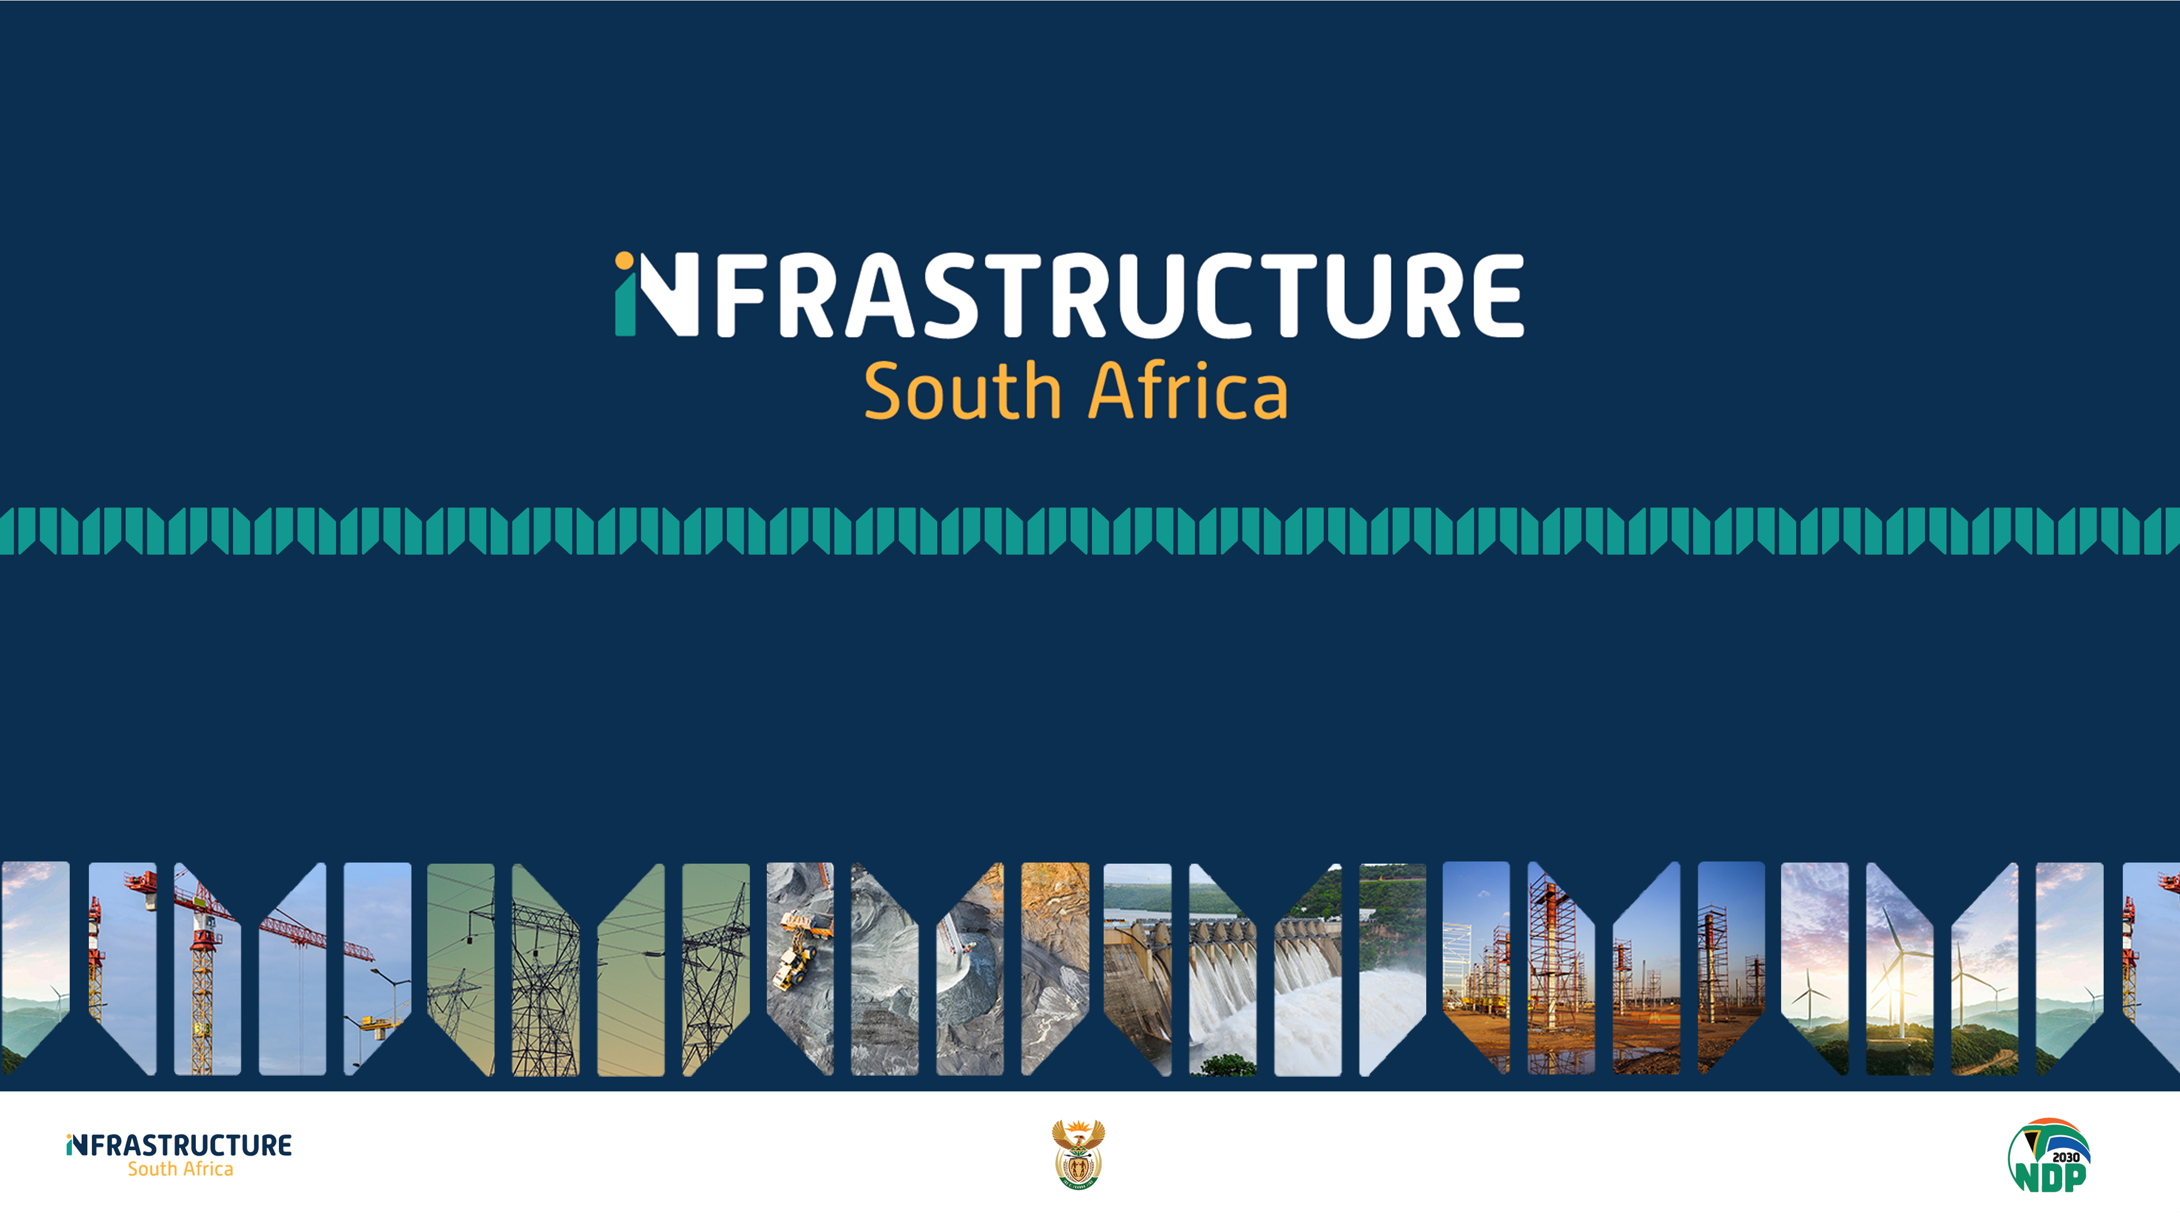
Free State Investment Conference
Infrastructure Investment Opportunities in the Free State Province
By: Dr Hubert Joynt (PhD, D.Com)

Slide 2
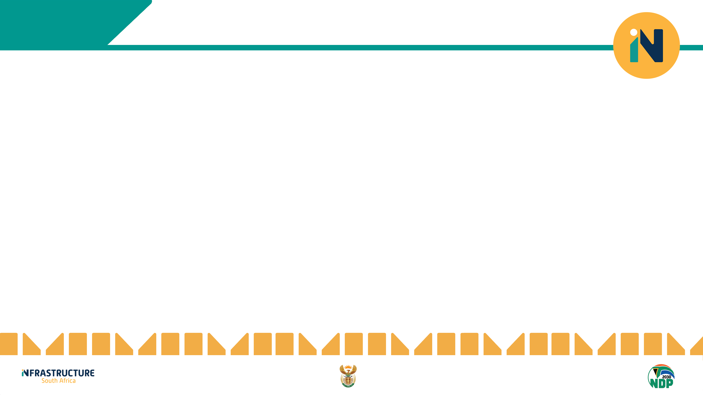
OUTLINE OF SALIENT ECONOMIC POINTS
1
INVESTMENT TRENDS
2
ECONOMIC INDICATORS
“Economics is like gravity: Ignore it and you will be in for some rude surprises”
Charles Wheelan
3
CONSTRUCTION SECTOR
4
TAX BASE
5
TRANSPORT AND LOGISTICS INFRASTRUCTURE
6
CONSUMPTION SPENDING
7
INVESTMENT OPPORTUNITIES

Slide 3
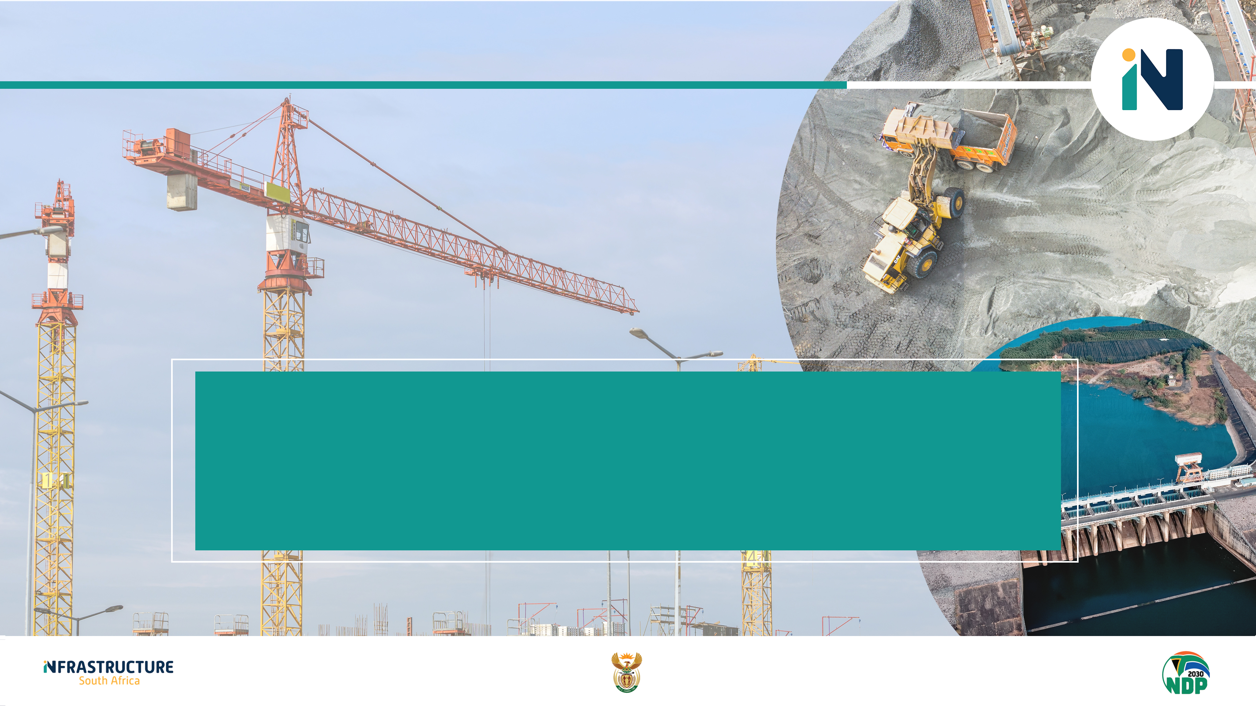
FREE STATE INVESTMENT TRENDS

Slide 4
GROSS FIXED CAPITAL FORMATION – FREE STATE PROVINCE
Source: Quantec
Source: Quantec
Gross Fixed Capital Formation comprises fixed asset acquisitions minus disposals by resident producers in an economy. There are various asset categories. Free State Province had a Gross Fixed Capital Formation (GFCF) of around R38,24 billion in 2022. The percentage share is about 5,72% of GFCF in the country (second-lowest among provinces). GFCF in Buildings and Construction was only at R13,53 billion.

Slide 5
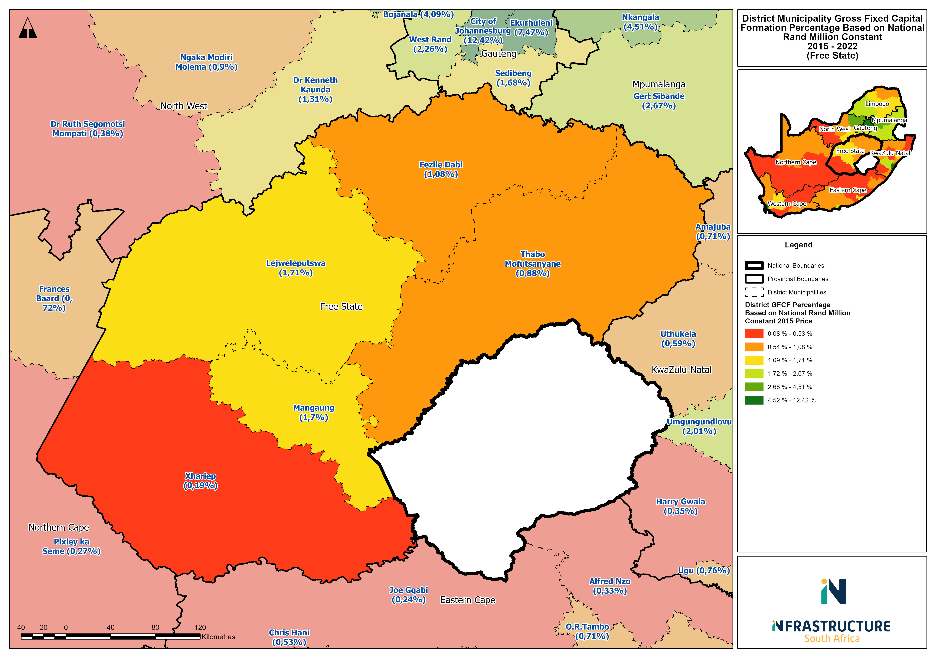
MEASURING INFRASTRUCTURE PERFORMANCE – GFCF AND SPATIAL DISPARITIES IN FREE STATE
GFCF at FS District Level
Spatial Disparities quite evident in the Free State Province
Mangaung and Lejweleputswa district had the highest GFCF in FS as shown in the map.
Low GFCF in the Xhariep District Municipality GFCF District contributions (2022):
  Xhariep (2,86%)
  Thabo Mofutsanyane (16,05%)
  Fezile Dabi (19,39%)
  Lejweleputswa (30,29%)
  Mangaung (31,40%)
GFCF declining gradually across most of the districts in the FS
Source: Infrastructure South Africa and Quantec

Slide 6
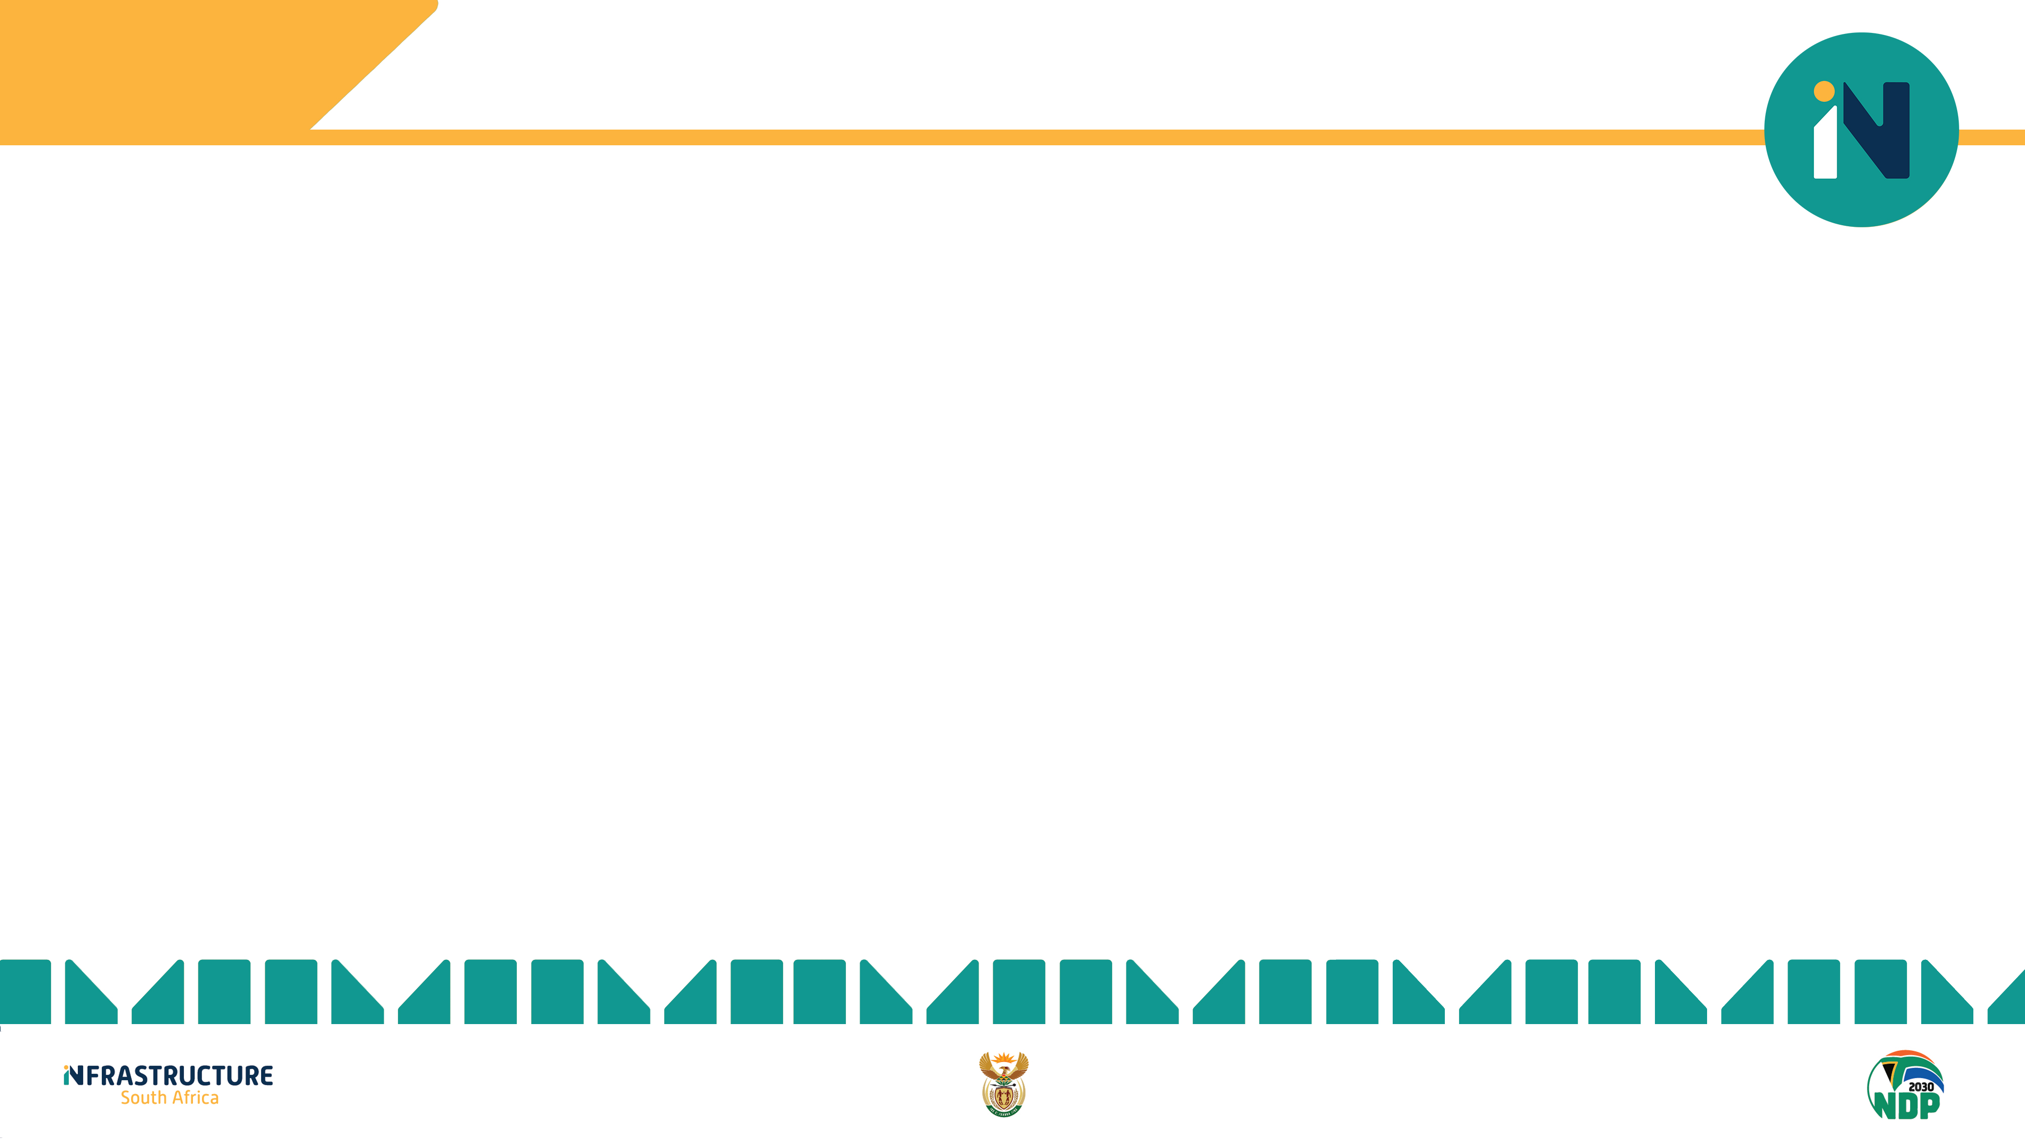
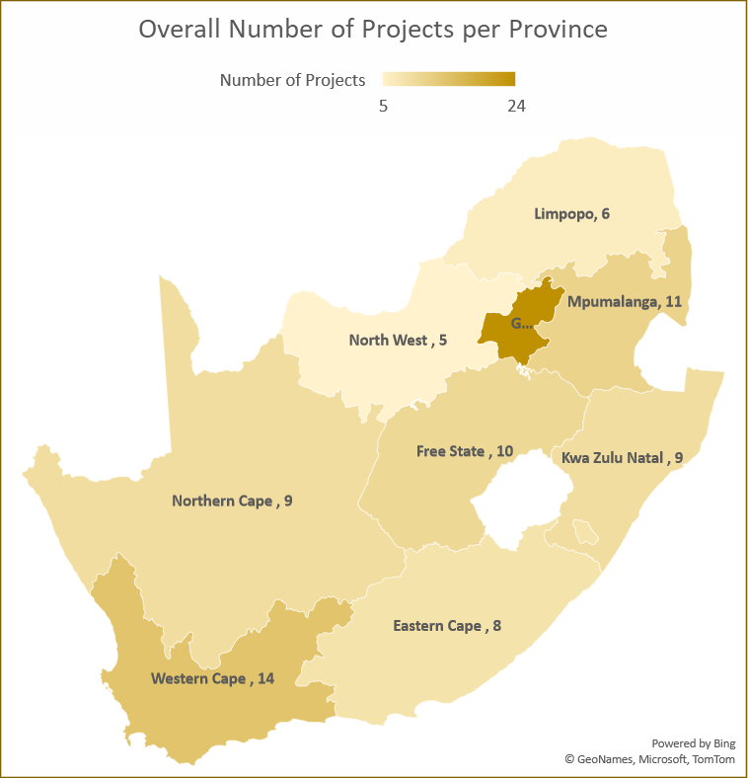
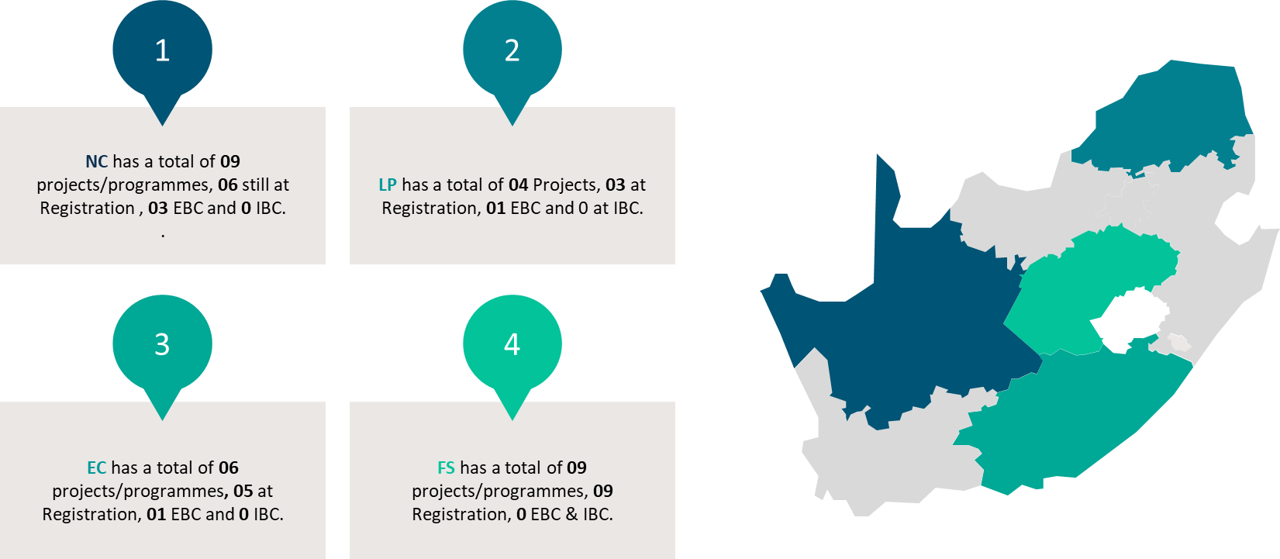
SPATIAL DISTRIBUTION OF ISA PIPELINE –
IIRC REGISTERED PROJECTS
Gauteng 20
FS has a total of 10 projects/programmes, 10 Registration, 0 EBC & IBC.
Free State has 10 projects that have been registered and approved.
All projects are at registration stages – Prefeasibility or Feasibility studies.

Slide 7
FREE STATE ECONOMIC INDICATORS

Slide 8
FREE STATE AND DISTRICTS TRESS INDEX
TRESS INDEX | 2012 | 2022
Free State | 32,3 | 35,9
Xhariep | 38,0 | 40,3
Lejweleputswa | 39,0 | 34,3
Thabo Mofutsanyane | 39,2 | 42,6
Fezile Dabi | 38,4 | 39,9
Mangaung | 48,8 | 51,6
The sectoral composition of economic activity in a region is a good indication of the level of diversification or concentration of a region's economy.
A tress index of zero represents a totally diversified economy.
The higher the index (closer to 100), the more concentrated or vulnerable the region’s economy to exogenous variables.
The increase in the Tress index for the Free State reflects an increase in the dependence on the local economy and the economy’s diversification
Mangaung’s economy is concentrated, noting that its Tress Index is at the midpoint of the index range.
Source: Quantec

Slide 9
FREE STATE AND DISTRICT LOCATION QUOTIENT (LQ)
LOCATION QUOTIENT | Location quotient relative to Province |  |  |  |  |  |  |  |  |  | Location quotient relative to National
District/ Province | Xhariep |  | Lejweleputswa |  | Thabo Mofutsanyane |  | Fezile Dabi |  | Mangaung |  | Free State
Sector | 2012 | 2022 | 2012 | 2022 | 2012 | 2022 | 2012 | 2022 | 2012 | 2022 | 2012 | 2022
Agriculture, forestry and fishing | 3,82 | 3,63 | 1,02 | 1,11 | 1,89 | 1,86 | 1,06 | 1,05 | 0,26 | 0,26 | 2,42 | 2,00
Mining and quarrying | 0,35 | 0,77 | 3,67 | 3,59 | 0,02 | 0,04 | 0,47 | 0,66 | 0,03 | 0,05 | 1,27 | 1,12
Manufacturing | 0,47 | 0,47 | 0,72 | 0,85 | 0,79 | 0,70 | 2,17 | 2,29 | 0,73 | 0,63 | 0,80 | 0,88
Electricity, gas and water | 1,18 | 0,91 | 0,74 | 0,78 | 0,76 | 0,72 | 1,40 | 1,25 | 1,08 | 1,16 | 1,15 | 1,22
Construction | 1,28 | 1,19 | 0,82 | 0,91 | 1,08 | 0,99 | 1,10 | 1,18 | 1,00 | 0,96 | 0,65 | 0,73
Wholesale and retail trade, catering and accommodation | 1,06 | 1,14 | 0,94 | 1,01 | 1,17 | 1,16 | 0,84 | 0,80 | 1,03 | 1,01 | 0,97 | 0,98
Transport, storage and communication | 0,88 | 0,86 | 0,76 | 0,82 | 0,95 | 0,88 | 0,86 | 0,82 | 1,27 | 1,27 | 1,06 | 1,06
Finance, insurance, real estate and business services | 0,54 | 0,57 | 0,75 | 0,80 | 0,87 | 0,87 | 0,82 | 0,78 | 1,36 | 1,34 | 0,84 | 0,79
General government | 1,16 | 0,92 | 0,72 | 0,73 | 1,20 | 1,16 | 0,85 | 0,88 | 1,15 | 1,15 | 1,36 | 1,40
Community, social and personal services | 1,06 | 0,98 | 0,78 | 0,81 | 1,21 | 1,21 | 0,78 | 0,79 | 1,15 | 1,13 | 0,97 | 0,99
Source: Quantec
Location Quotient – This is an indication of the comparative advantage (higher than 1) of a specific sector when compared to the aggregate economy.

Slide 10
FREE STATE AND FS DISTRICTS GROWTH PERFORMANCE INDEX
Growth Performance Index (GPI) – 2012 to 2022 | Xhariep Relative to the Province | Lejweleputswa Relative to the Province | Thabo Mofutsanyane Relative to the Province | Fezile Dabi Relative to the Province | Mangaung Relative to the Province | Free State Relative to the Nation
Agriculture, forestry and fishing | 94,71 | 103,28 | 99,41 | 98,73 | 102,62 | 80,37
Mining and quarrying | 217,11 | 93,23 | 176,31 | 141,26 | 195,76 | 85,54
Manufacturing | 99,39 | 112,90 | 89,44 | 106,01 | 88,18 | 106,57
Electricity, gas and water | 76,59 | 100,11 | 95,53 | 90,00 | 110,37 | 102,82
Construction | 93,18 | 104,77 | 92,44 | 108,00 | 97,76 | 108,83
Wholesale and retail trade, catering and accommodation | 106,95 | 101,75 | 99,29 | 95,33 | 100,73 | 97,86
Transport, storage and communication | 97,06 | 103,28 | 93,43 | 95,55 | 102,96 | 97,82
Finance, insurance, real estate and business services | 103,93 | 101,08 | 100,67 | 94,77 | 100,88 | 91,17
General government | 79,29 | 97,23 | 97,58 | 104,68 | 102,40 | 99,51
Community, social and personal services | 92,85 | 98,80 | 100,19 | 101,83 | 100,35 | 98,33
Source: Infrastructure South Africa and Quantec
The Growth Performance Index provides an indication of the growth in a certain sector in the economy relative to the growth attained in the same sector in the provincial economy. An index larger than 100 indicates a leading sector.
The Free State has a growth opportunity in manufacturing and electricity, gas and water industries.

Slide 11
FREE STATE CONSTRUCTION SECTOR

Slide 12
CONSTRUCTION INDUSTRY GROSS VALUE ADDED (GVA)
Free State’s construction industry GVA was about R3,948 billion in 2022.
The FS construction industry GVA accounts for 3,6% of the total GVA in the country.
Mangaung has the highest GVA in the province, with Fezile Dabi with the second-highest GVA in construction among the districts.
Xhariep has the lowest GVA in the construction industry in the Free State province, with a significant gap from the other districts over the period.
Source: Quantec

Slide 13
EMPLOYMENT
Source: StatsSA
Source: StatsSA
Employment in the Free State was 747,000 in 2023, which declined from 2022. The unemployment rate in the Free State is high at 36,65%.
Construction employment for all the provinces. Free State has one of the lowest employment numbers in construction at 41 000 in 2023.

Slide 14
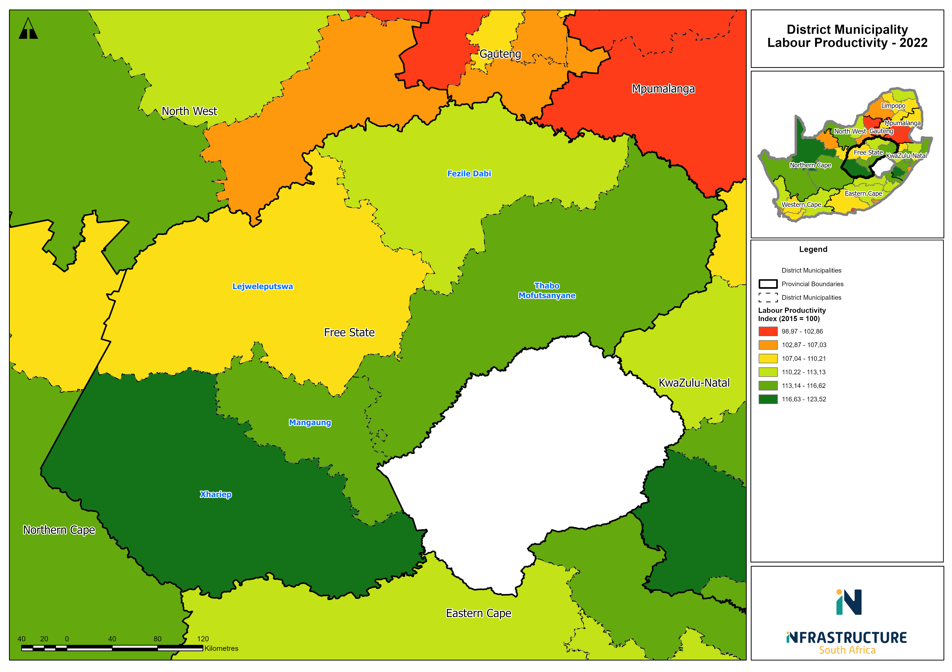
MEASURING INFRASTRUCTURE PERFORMANCE – LABOUR PRODUCTIVITY – CONSTRUCTION
Source: Infrastructure South Africa and Quantec
Source: Infrastructure South Africa and Quantec
Labour productivity shows how efficiently labour is used to generate output. Data suggests a slight improvement in labour productivity across the industries, noting the construction industry has declined in the last decade.

Slide 15
FREE STATE TAX BASE

Slide 16
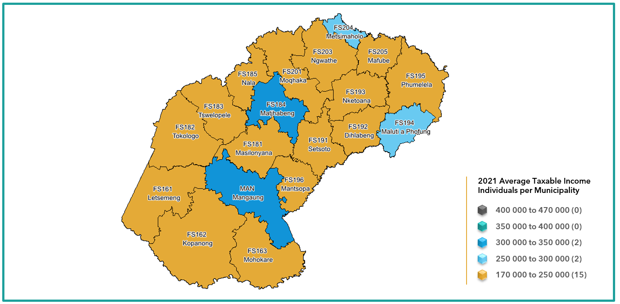
FREE STATE TAX STATISTICS
Tax year | 2020 |  |  |  | 2021
Province¹ | Number of taxpayers | Taxable Income (R million) | Tax assessed (R million) | Average taxable income (R) | Number of taxpayers | Taxable Income (R million) | Tax assessed (R million) | Average taxable income (R)
Eastern Cape | 455 939 | 130 177 | 24 329 | 285 514 | 470 484 | 126 950 | 22 620 | 269 829
Free State | 265 867 | 73 062 | 14 042 | 274 807 | 260 655 | 72 105 | 13 275 | 276 630
Gauteng | 2 055 969 | 826 817 | 201 390 | 402 154 | 2 001 810 | 772 124 | 181 122 | 385 713
KwaZulu-Natal | 854 070 | 256 945 | 51 413 | 300 848 | 835 090 | 245 011 | 46 904 | 293 395
Limpopo | 267 660 | 82 492 | 16 386 | 308 197 | 275 124 | 83 655 | 16 043 | 304 063
Mpumalanga | 335 087 | 103 436 | 21 830 | 308 684 | 325 161 | 97 356 | 19 678 | 299 409
North West | 251 350 | 75 077 | 15 514 | 298 695 | 244 511 | 72 608 | 14 564 | 296 952
Northern Cape | 115 218 | 34 831 | 7 009 | 302 305 | 115 083 | 34 172 | 6 597 | 296 934
Western Cape | 1 003 326 | 335 823 | 75 351 | 334 710 | 980 607 | 313 395 | 67 258 | 319 593
Total | 5 604 486 | 1 918 660 | 427 264 | 342 344 | 5 508 525 | 1 817 376 | 388 061 | 329 921
Average taxable income for Free State province, 2021
Source: SARS
During 2020 Free State had the lowest average taxable income
During 2021 Free State lost about 5 000 taxpayers
Only 9% of the Free State population is paying tax.
There is a need to increase income levels and broader the tax base

Slide 17
TRANSPORT AND LOGISTICS INFRASTRUCTURE

Slide 18
MEASURING INFRASTRUCTURE PERFORMANCE – TRANSPORT LOGISTICS
Indicates the willingness or openness of a country to engage other countries in terms of trade.
Measured as the sum of exports and imports relative to GDP.
Financial crisis can clearly be seen by the significant drop in 2009.
In 2015, the ratio peaked at 56,7. There is a definite recovery since 2020, but the 2022 level has not exceeded that of 2015.
Source: Infrastructure South Africa and Quantec
Source: Statistics South Africa and ISA

Slide 19
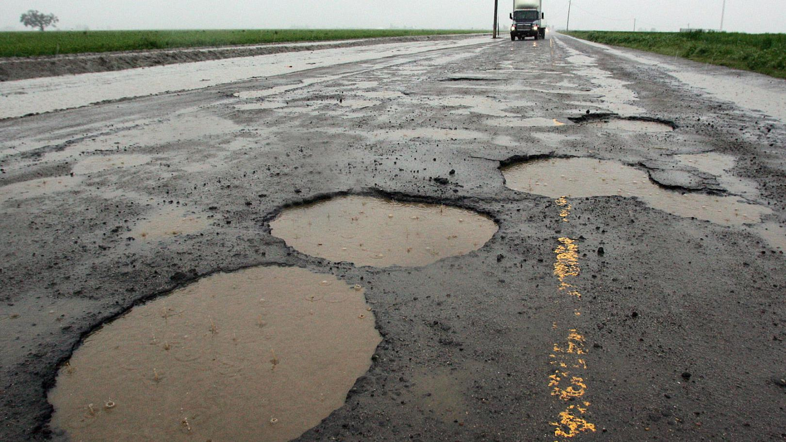
MEASURING INFRASTRUCTURE PERFORMANCE – TRANSPORT LOGISTICS
Although maintenance and expansion of road freight is critical, the demand for this method is putting significant strain on the current infrastructure.
This allows for investment opportunities into freight transport infrastructure.
Clear increase in payload since 2008 for road freight versus a decline in rail.
Source: Statistics South Africa and ISA
In relation to total freight, road transport payload has always outperformed the contribution of rail.
However, the contribution of payload being transported by rail freight over the years to total, it has decline while road freight’s contribution has increased.
In 2022 – Road (84.3%) and Rail (15.7%).

Slide 20
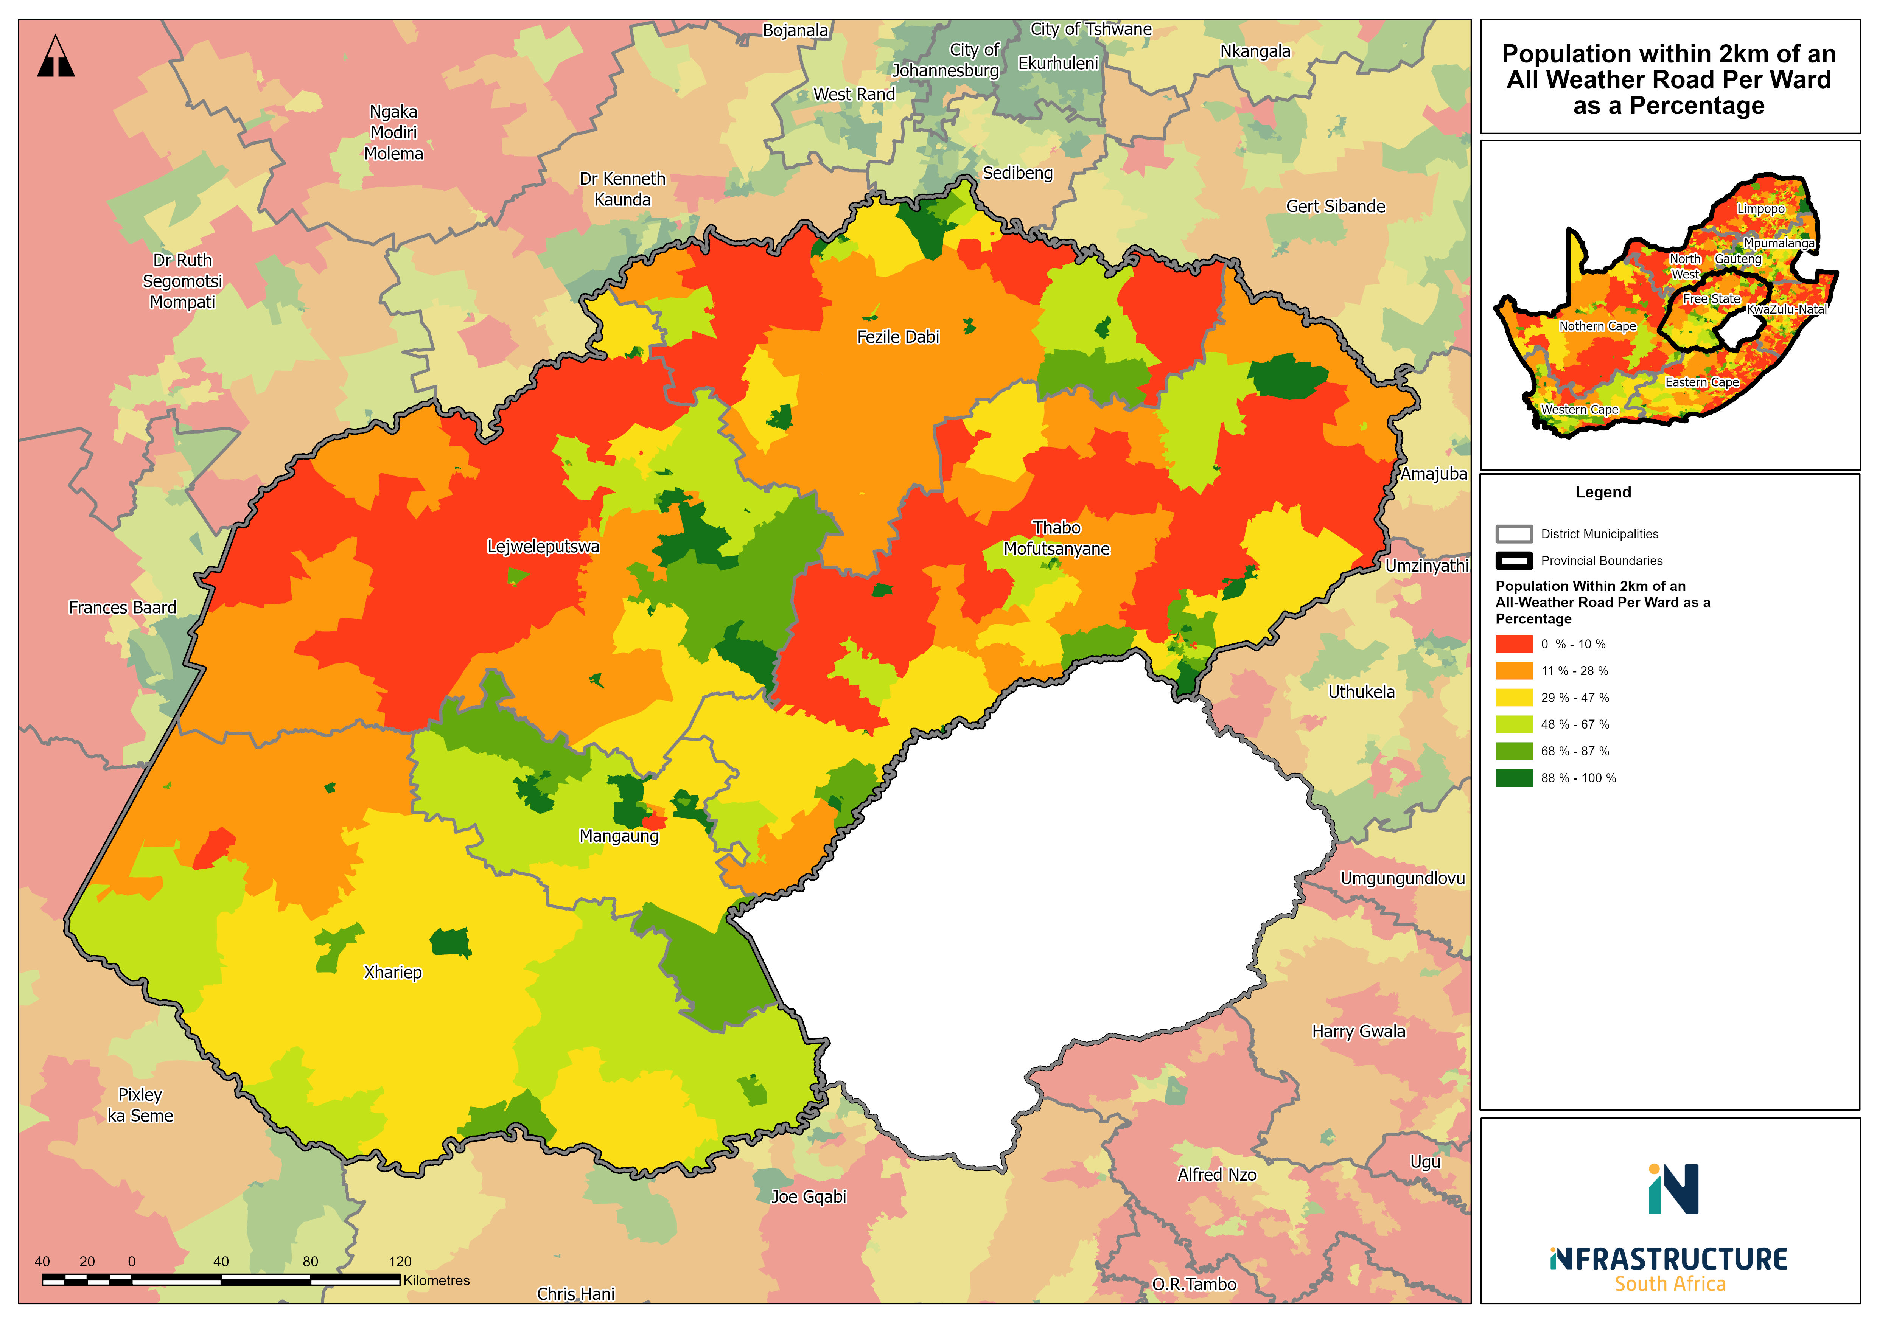
MEASURING INFRASTRUCTURE PERFORMANCE – RURAL ACCESS INDEX FOR FREE STATE
Source: Infrastructure South Africa
Source: Infrastructure South Africa
47% of the South African population, 68% of the urban population and only 30 % of the population located in rural municipalities are within the threshold.

Slide 21
FREE STATE CONSUMPTION SPENDING

Slide 22
FREE STATE HOUSEHOLD EXPENDITURE
Item | Location | 2020 | 2021
HH Consumption (Rand Million) | SA | 358 937 | 404 571
 | FS | 17 699 | 20 006
After Tax Income (Rand Million) | SA | 1 491 396 | 1 429 315
 | FS | 59 020 | 58 830
% Spend on Transport | FS | 22,5% | 25,5%
Source: Quantec
Consumption by Good Type | South Africa | Free State
Durable Goods | 9,0% | 9,5%
Semi-Durable Goods | 7,5% | 8,7%
Non-Durable Goods | 33,6% | 35,0%
Services | 49,9% | 46,8%
Source: ISA calculations based on SARS and Quantec data
Benchmark 10%
Notes:
Household consumption in South Africa and Free State province has increased significantly in the last decade, with Free State contributing about 5,4% on average to the national total.
In 2022, most of the disposable income was used for services (50% for SA and about 47% for the province). These services include rent, transportation and recreation, among others.
Households spent over a third of their income on non-durable goods in the nation and Free State, followed by non-durable goods.

Slide 23
FREE STATE INFRASTRUCTURE INVESTMENT OPPORTUNITIES

Slide 24
FREE STATE POTENTIAL INVESTMENT OPPORTUNITIES
Industry | GPI | LQ
Agriculture, forestry and fishing | 80,37 | 2,00
Mining and quarrying | 85,54 | 1,12
Manufacturing | 106,57 | 0,88
Electricity, gas and water | 102,82 | 1,22
Construction | 108,83 | 0,73
Wholesale and retail trade, catering and accommodation | 97,86 | 0,98
Transport, storage and communication | 97,82 | 1,06
Finance, insurance, real estate and business services | 91,17 | 0,79
General government | 99,51 | 1,40
Community, social and personal services | 98,33 | 0,99
Potential economic investment opportunities for Free State based on the LQ and GPI include:
Primary sector investment: FS shows a comparative advantage in agriculture and mining, suggesting potential export opportunities as well as inputs for manufacturing.
Manufacturing: industry activities can be expanded to enhance agro-processing and mineral beneficiation, leveraging on the relatively strong primary sector. The expansion also supports activities within the Maluti-A-Phofong SEZ and presents export opportunities.
Enhancing the utilities industry: FS shows high economic potential in the electricity, gas and water industry. This may suggest potential opportunities for natural gas exploration and extraction, as well as integrating renewable energy sources.
Infrastructure: rehabilitation of existing infrastructure will play a crucial role in creating a conducive economic environment. Investment in enhancing logistics will improve accessibility as well as enhance transportation and warehousing capabilities in support of the SEZ.
Source: Quantec

Slide 25

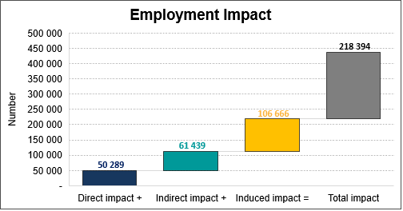
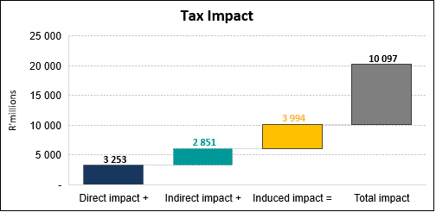
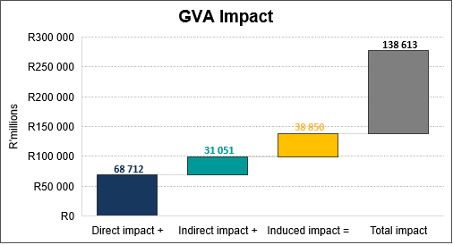
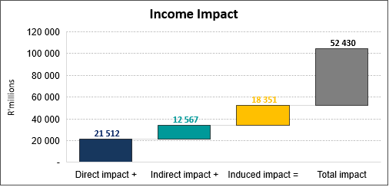
ENERGY SECTOR PROJECTS ECONOMIC IMPACT
21 Projects
R143.8 bn value
Source: ISA Calculations

Slide 26
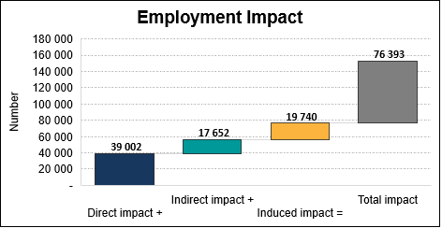
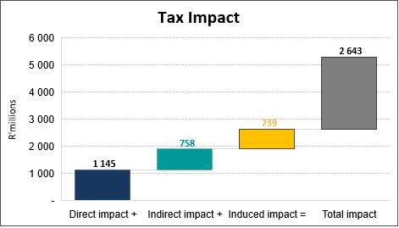
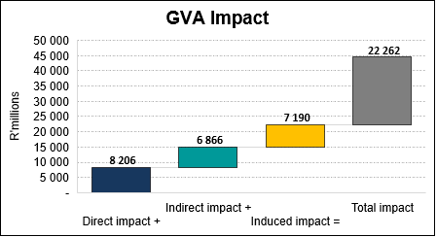
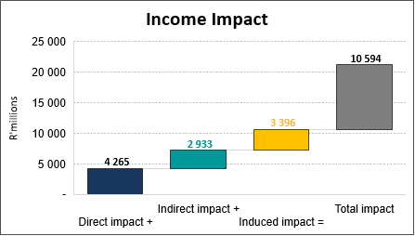
HUMAN SETTLEMENTS PROJECTS AND IMPACT
3 Projects
R22.8 bn value
Source: ISA Calculations

Slide 27
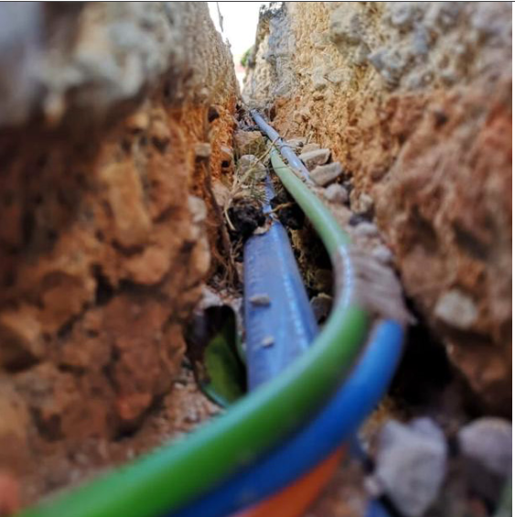
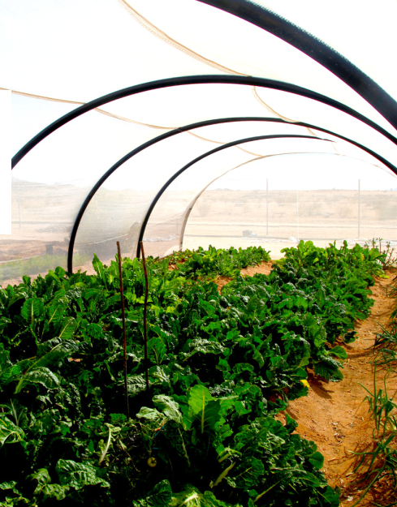
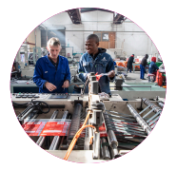
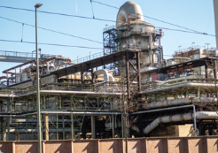

Country Investment Strategy Update - ‘Big Frontiers’
The CIS seeks to close the gap in South Africa’s investment efforts by addressing the absence of structured coordination of the various mandates and processes relevant to mobilising, promoting, designing, implementing and enabling investment, which undermines the country’s strategic capacity to realise the NDP targets.
South Africa has identified and packaged 5 strategic investment attraction initiatives, elevated as country strategic projects to drive levels of FDI to match the ambitions of the NDP 2030.
Big Frontiers will require partnership between public and private sectors, and investment mobilised under 4 Categories of State Action i.e. Convening & Clustering Investors & Sectors, Catalytic Co-Investment, Catalytic Infrastructure & Regulatory Enabling
Big Frontier 1
Next Generation Digital Industries & Infrastructure
Big Frontier 2
Cannabis & Advanced Agro-Processing
Big Frontier 3
Advanced Manufacturing & Logistics Networks targeting Exports
Big Frontier 4
Mineral Beneficiation leading to Localisation (supporting industrial and mineral value chains)
Big Frontier 5
Green Hydrogen

Slide 28
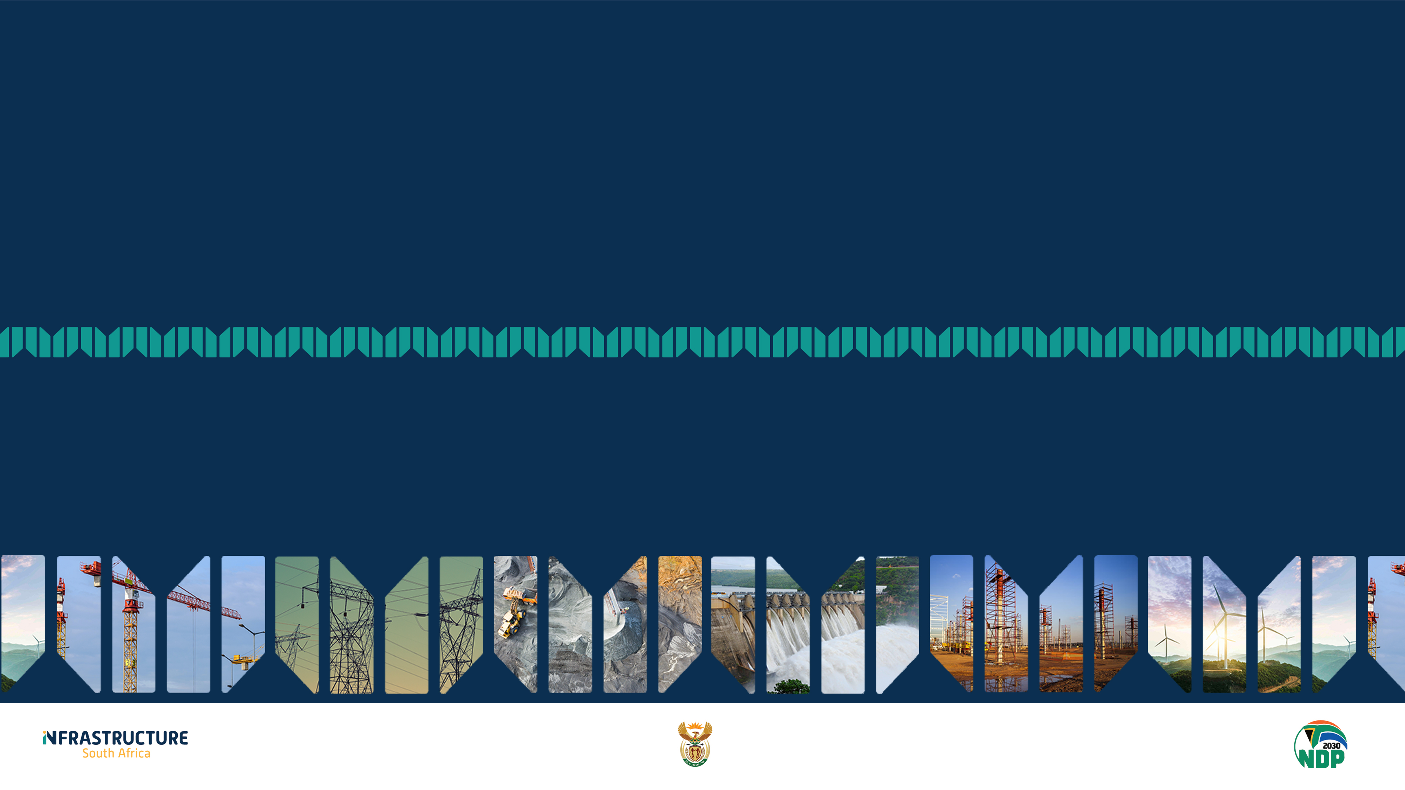
THANK YOU
“Economics is everywhere, and understanding economics can help you make better decisions and lead a happier life” Tyler Cowen

